Slide 1
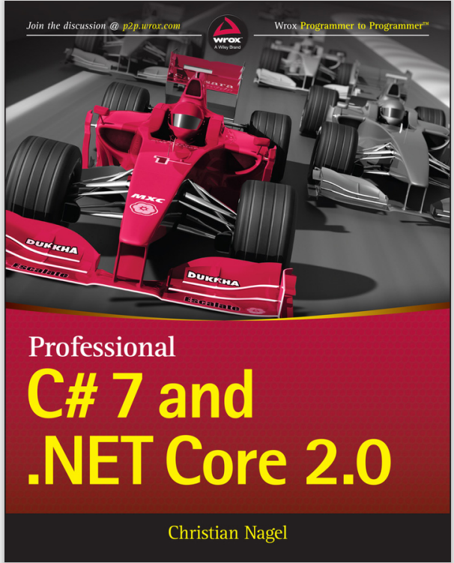
Programming
Chapter 6
Loop Statements
[Book name]

Slide 2
topics
for loop
do… while loop
while loop

Slide 3
What is loop?
A loop is a control statement that allows repeating execution of a block of statements
May execute a code block fixed number of times
May execute a code block while given condition holds
May execute a code block for each member of a collections
Loops that never end are called a infinite loops

Slide 4
General form of a for loop
General form
for (expression1; expression2; expression3 )
{
// one or more statements;
}
Expression1
Initializes counter/index variable
Is usually an assignment statement
Is executed once at the beginning (only once)
Expression 2
Sets terminating condition
Is evaluated at the beginning of every iteration
If true statements inside the loop is executed; if false exit the loop
Expression 3
Is the loop variant/modifier (increment/decrement)
Is evaluated at the end of every iteration

Slide 5
For statement
for (initialization ; condition ; increment / decrement ){
// one or more statements;
}
?
true

Slide 6
For statement
for (initialization ; condition ; increment / decrement ){
// one or more statements;
}
?
true

Slide 7
For statement
for (initialization ; condition ; increment / decrement ){
// one or more statements;
}
?
true

Slide 8
For statement
for (initialization ; condition ; increment / decrement ){
// one or more statements;
}
?
false

Slide 9

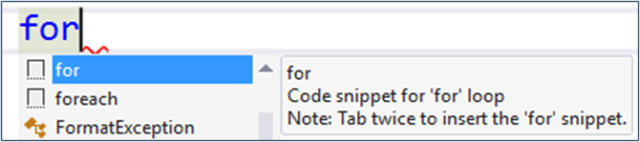
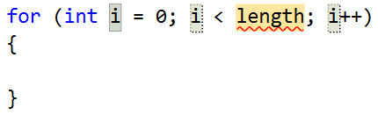
Example: Divisible by 3
Print the numbers from 1 to 100, that are divisible by 3
You can use "for" code snippet in Visual Studio
for (var i = 3; i <= 100; i += 3)
{
Console.WriteLine(i);
}
Push [Tab] twice

Slide 10
For loop example - requirement
Make a program to display this message, using for loop
This is a
nice
nice
nice
nice
nice
nice
world!

Slide 11
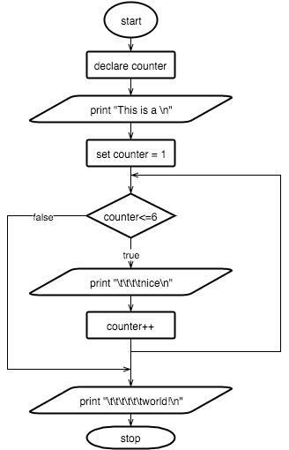
Flow chart

Slide 12
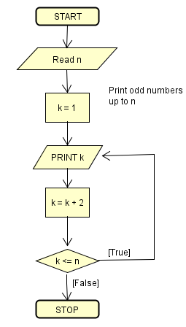
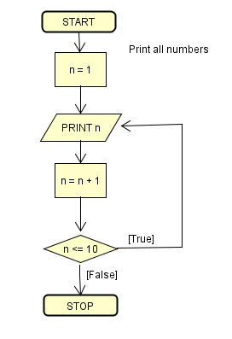
DEMO & Exercise
Print numbers up to 10
Print even numbers up to 10
Print odd numbers up to given n

Slide 13
While Loops
Executes commands while the condition is true:
Initial value
var n = 1;
while (n <= 10)
{
Console.WriteLine(n);
n++;
}
Condition
Loop body
Increment the counter

Slide 14
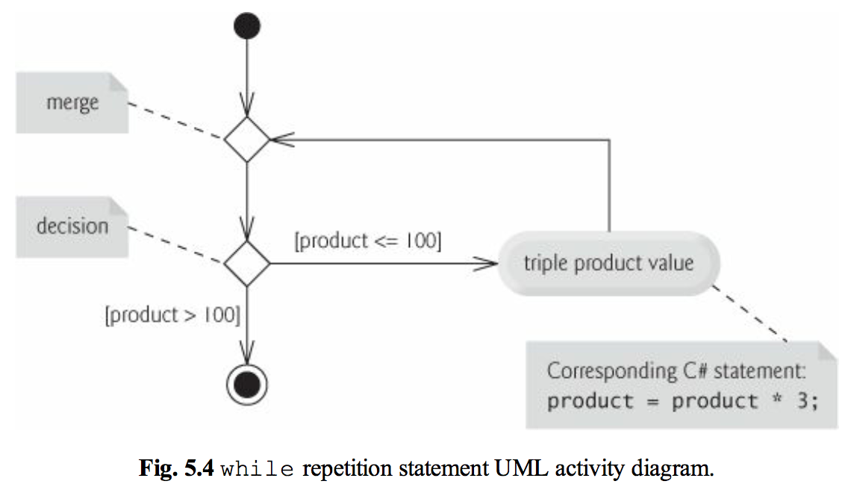
While Loops

Slide 15
Counter-controlled repetition
Counter-controlled repetition
Uses a counter (control variable) to control the number of times statements will execute
It is definite repetition (# of repetitions are known in advanced)

Slide 16
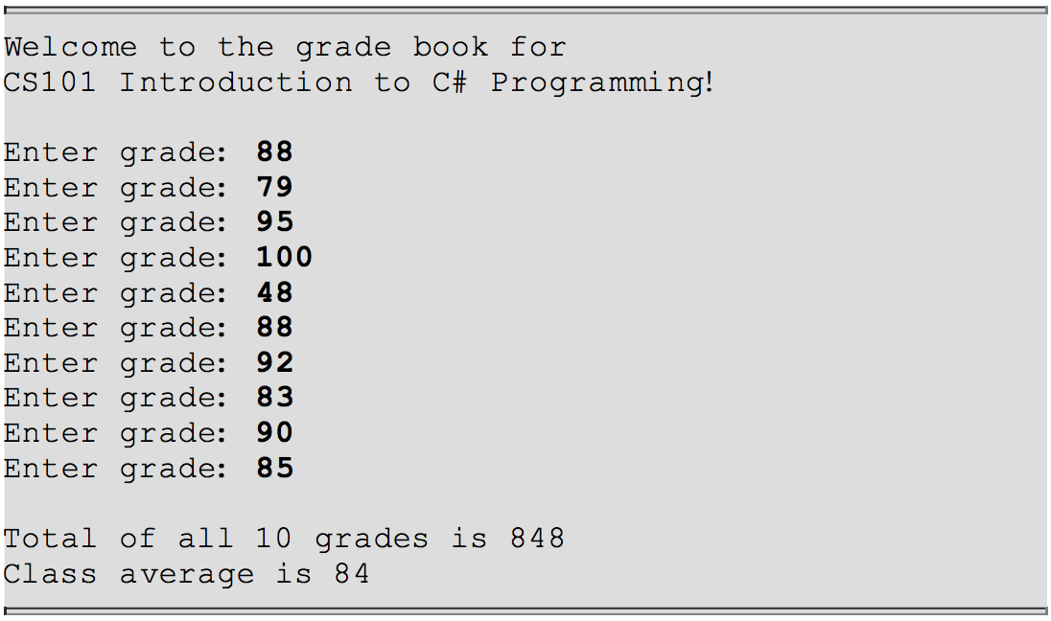
Activity: Average grade

Slide 17
Sentinel-control Repetition
The number of loops is controlled by a sentinel value (signal value, dummy value, flag value)
This is also called indefinite repetition
The number of repetitions is not known in advanced
Sentinel value should be chosen so it is not confused with the input value
E.g., repeatedly input the grade until inputting -1
-1 is the sentinel value, different from normal grades

Slide 18
Activity: Sentinel-controlled repetition
Develop the class average program
However, allows user to input the grade until user input -1 to finish
Calculate the class average

Slide 19
Nested control statements: Activity
Create a program to analyze results of exam
Input 10 test results, each as 1: passed or 2: failed
Count number of test results of each type
Display a summary (total of passed, failed)
If more than eight students passed, display a bonus message

Slide 20
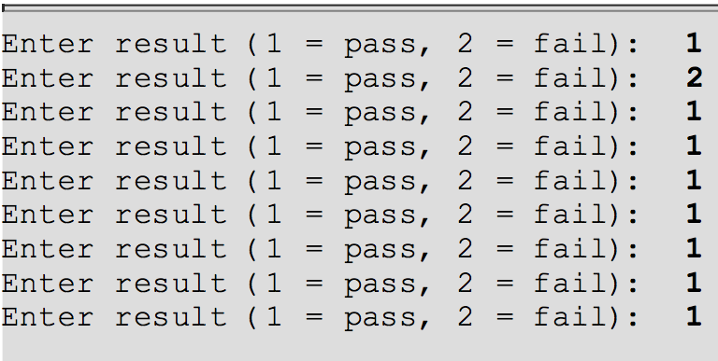
Nested control statements: Activity

Slide 21
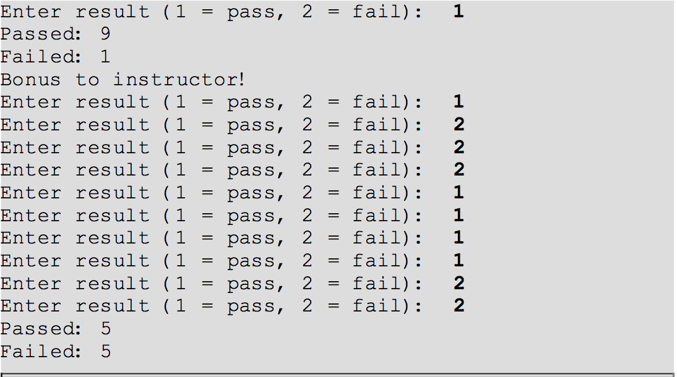
Nested control statements: Activity

Slide 22
The “do-while” loop
Syntax
do {
//one or more statements;
} while (condition is true);
Program will always execute the loop body first
The body is always executed at least once
At the end of every loop, condition is evaluated
If it’s true, the loop continues
If it’s false, the loop finishes
The do-while statement must be terminated with ‘;’

Slide 23
Activity: do-while loop
Using do-while loop, please:
Make a program to display odd integers in the range 1 to 10
Make another program to display even integers in the range 1 to 10

Slide 24
The break statement
The break statement can appear in the switch statement and the loop statement
It causes the execution of the current enclosing switch case or the loop to terminate
When it is encountered, all the rest of the codes after the break inside the code block are skipped
General syntax: break;

Slide 25
Activity – break example
Write a program to display numbers from 1 to 10 and break before 5

Slide 26
The continue statement
The continue statement can only appear in the the loop statement
It’s used to terminate the current iteration only
It skips the rest of the statements in the body of the loop and begins next iteration
General syntax: continue;

Slide 27
Activity – continue example
Write a program to display numbers from 1 to 10 and skip at 5

Slide 28
Activity: factorial – requirements (Homework)
Make a program to find factorial number from an input integer
Specified as
If n is < 0 display invalid input
If n = 0 or 1, n!=1
Otherwise, n!= 1*…*i; where i<=n

Slide 29
Activity: factorial
Input:
A positive integer
Process:
If n = 0 or 1, n!=1
Otherwise, n!= 1*…*n;
Output:
The factorial of the input integer

Slide 30
Sumary

